Slide 1
An Introduction to RFgen Mobile Foundations for SAP Business One
Presented by:
Sales Consultant

Slide 2
Agenda
What are the Challenges?
Advantages of Automation
RFgen Software Overview
RFgen Mobile Foundations for SAP Business One
The Wireless Warehouse
How to Achieve 24/7 Continuous Operation
SAP Business One Customer Success Story
Software Demonstration
Q&A

Slide 3
8 Challenges Solved with a Mobile Data Collection Solution
Growing Business
Margin Pressure
Government Regulations
Value from IT
Traceability
Accuracy
Scalability
Customer Service
Notes:
Growing Business
Your business is growing and needs to increase throughput to keep from having to develop or purchase more facilities.
Margin Pressure
Margin pressure from competitive market forces and increased costs is causing pressures to look for savings throughout the business.
Government Regulations
Faced with changing and expanding regulatory requirements, you need to ensure compliance with ePedigree requirements, maintain tracking of lot/batch/country of origin, comply with FDA Bioterrorism Act requirements and more.
Value from IT
You want to get more output from you existing IT infrastructure – without putting day-to-day operations at risk.
Traceability
You are being asked to support the Produce Traceability Initiative (PTI) to ensure complete produce traceability and support GS1 standards.
Accuracy
Providing more “perfect orders” is a top objective in enhancing customer service. To achieve this, you need to offer solutions for improving shipment accuracy and timeliness of delivery.
Scalability
You’re evaluating processes to keep pace with the growth of your online business and find a solution to address the line item order fulfillment business amid a changing mix of product shipments.
Customer Service
Your business continues to look for ways to provide competitive differentiators and customer service offerings.

Slide 4

Paper-Based and Manual Processes Create Inefficiencies

Slide 5

It also Makes it Difficult to Get Real-Time Visibility into Inventory

Slide 6
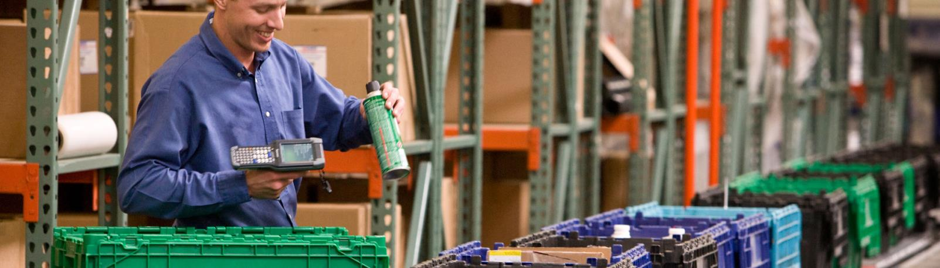
What You Need are Barcode and Mobile Solutions to Track Inventory in Real-Time

Slide 7
RFgen Software Overview

Slide 8

Who is RFgen Software?
Established in 1983
SAP-Certified Integration
Global Reach
SAP Business One versions 9.1
2,800 worldwide installations
140 partners worldwide
Regional support in 35+ countries
Total Solution Provider
Certified Partner
Software
Hardware
Professional Services
SAP Partner
Oracle Gold Partner
Deltek Premier Partner

Slide 9
RFgen Mobilizes the Supply Chain
Integrated ERP Solutions
Supply Chain Accelerators
And More
Industry Solutions
Aerospace & Defense
SAP Business One
Deltek Costpoint
And More
Warehouse Automation
Voice Picking
Remote Warehouse Automation
Feed, Food & Beverage
Life Sciences
Oil & Gas
Retail
CPG
Engineering, Construction & Industrial Supplies
High Technology
Industrial Machinery & Equipment
And More
Asset Management
Barcode Labeling
Inventory Management
Field Service
License Plating
Oracle E-Business Suite
JD Edwards
SAP
Shop Floor Data Collection

Slide 10
How is RFgen Different than a WMS?
WMS
Typically a combination of a desktop and handheld application.
A separate system with its own separate database.
Requires data synchronization between the ERP and WMS, which requires some management because you have two separate databases.
RFgen
An add-on mobile data collection software solution to the ERP.
Does not require a separate database because it processes transactions in real-time against the ERP.
A system that extends the functionality of the ERP onto a mobile device.
Typically has its own set of business rules and configuration that must be set up and managed.
A solution that utilizes the data and business rules already setup in the ERP.

Slide 11



The RFgen Mobile Framework
RFgen Software designs, implements and deploys mobile and wireless software, and open source supply chain solutions for automated data collection.
Barcoding
Voice
Roaming
Mobile

Slide 12
Where is RFgen Used?
Inside the Four Walls
Outside the Four Walls
Inventory Management
Warehouse Automation
Voice-Directed Operations
Manufacturing Operations
Field Service
Freight Yard Operations
Remote Inventory Management
Direct Store Deliver
Transportation and Logistics
Track and Trace

Slide 13







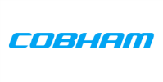















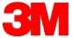

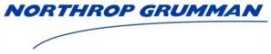



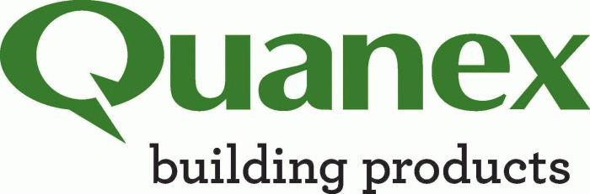







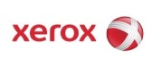















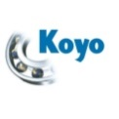

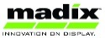
















































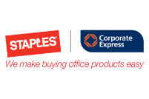
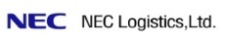









2,800+ Sites | 25+ Industries | 35+ Countries
Aerospace & Defense
Automotive
Consumer Packaged Goods
Electronics
Engineering & Construction
Feed, Food & Beverage
High Technology
Industrial Machine & Equipment
Life Sciences
Manufacturing
Oil & Gas
Pharmaceutical
Retail
Transportation & Logistics
Utilities & Energy

Slide 14
RFgen Mobile Foundations For SAP Business One

Slide 15
RFgen Mobile Foundations for SAP Business One
Mobile Application Development Platform
Tightly Integrated with SAP Business One
Out-of-the-Box Pre-Written Pre-Tested Mobile Apps
Architecture Facilitates Rapid Modification and Configuration
Supports Multiple Data Capture Scenarios for Real-time, Mobile and Batch Workflows

Slide 16


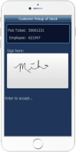
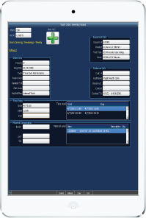

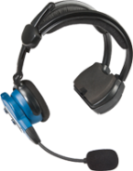
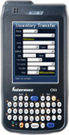
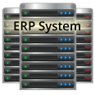
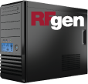

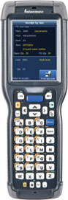
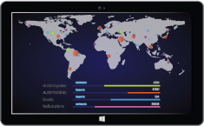
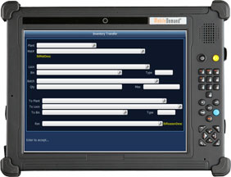
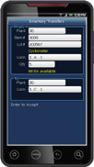
RFgen-SAP Business One Integration
Devices
Business Logic Integration
SAP B1 (DI SDK)
Data Integration
Business Data
Configuration Options
Real-Time Data Validation

Slide 17
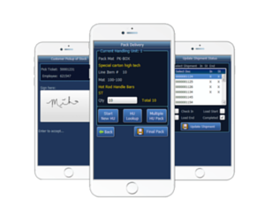
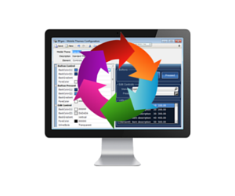
RFgen Framework for SAP Business One
Pre-Built Mobile Application Suite
Certified and pre-tested mobile applications
RFgen Mobile Development Studio
Drag and drop visual environment
Integrate with other shop floor systems
Change pre-built mobile apps or build new ones
Implement out of the box or customize
Built using data collection best practices

Slide 18
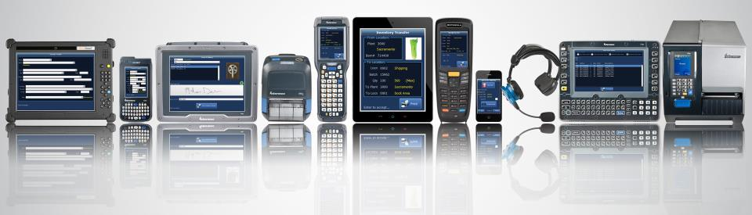
RFgen Extends SAP B1 to Any Data Collection Device Type
Operating Systems
Windows Mobile and CE
Android
iOS
Telnet
Data Collection Devices
Barcode Scanners
Tablets and Smartphones
Vehicle Mount Computers
Voice Recognition
RFID
And More
Machine-to-Machine (M2M)
Carousels and Scales
Sensors
Meters
Robots
And more
Notes:
RFgen can not only work with Android and iOS devices, but we also work with older technologies using Windows Mobile, Windows CE, and Telnet.
We haven’t run into any device RFgen couldn’t run on, but if we do we will get that device running at no charge.

Slide 19
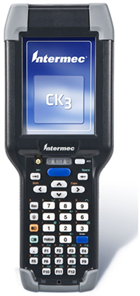
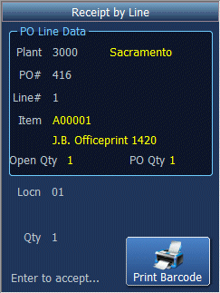
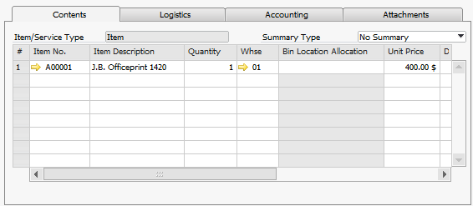
RFgen-SAP Business One Integration
RFgen on a Mobile Device
SAP Business One Screen
All data is validated against business data in SAP Business One.
All transactions are executed using the SAP Business One DI SDK.

Slide 20
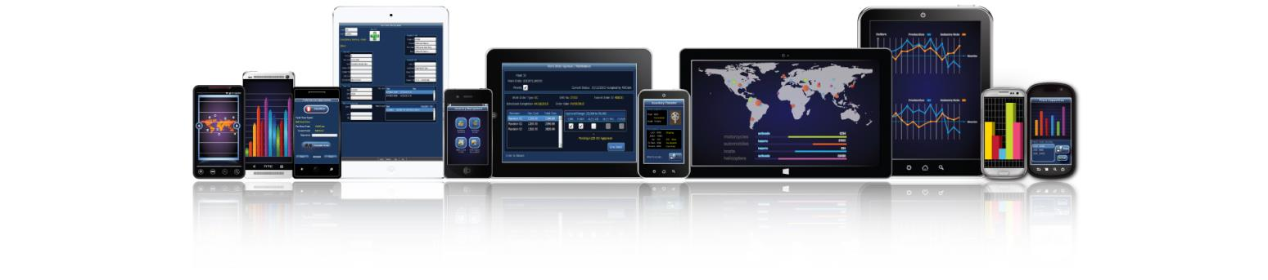
Pre-Built SAP B1 Mobile Apps Included
CUSTOMIZE AND CREATE YOUR OWN MOBILE APPS!
Inventory Management
Cycle Count
Inventory Adjustments
Inventory Transfer
Location Inquiry
Item Inquiry
Bin Inquiry by Item
Sales Order Processing
Pick Confirm
Packing Slip
Shipping
Production Management
PR Goods Issue
PR Receive Order
PO Processing
PO Receiving

Slide 21
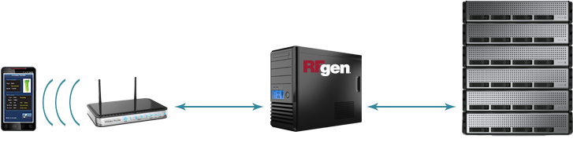
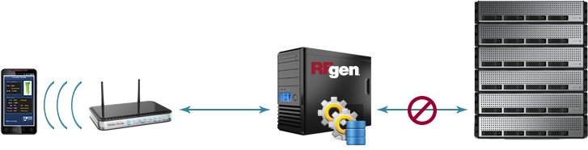

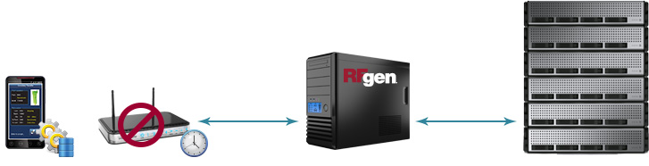
RFgen Connectivity Scenarios
Real-Time
High Availability
Offline Mobility

Slide 22
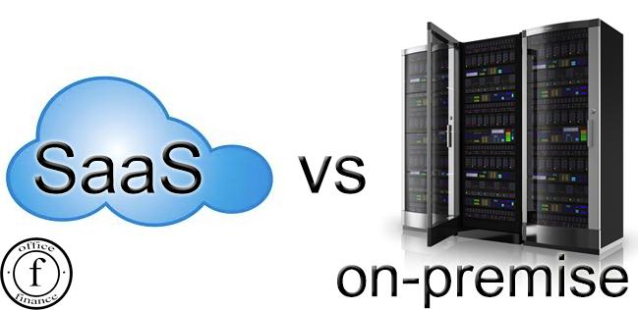
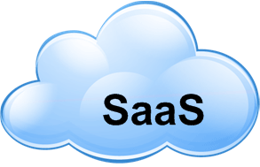
Deployment Options
Onsite use license
Eliminates privacy and security concerns
No capital expenditure
Annual payments
Minimizes internal IT requirements to deploy and manage
Run RFgen in your IT infrastructure
Maintain complete control of your entire RFgen platform
Manage complex data, analytics, or big data sets including networks, analysis, image services, or real-time sensor streams

Slide 23

Zero Footprint on SAP Business One Means Hassle-Free SAP B1 Upgrades
Nothing to Reinstall
The RFgen version is the same regardless of the SAP Business One version.
RFgen Can Reduce Custom Modifications
Move custom modifications from SAP Business One to RFgen.
RFgen is Non-Invasive
Simply redirect RFgen to the new environment and begin UAT.
No custom objects within SAP Business One to upgrade or retrofit.
Eliminates the need to retrofit.

Slide 24

RFgen Implements in Weeks, Not Months
Open Source Code Samples
Rapid Application Development Platform
No Cryptic Scripting Language
Uses Data Dictionary Aliases
Reusable Objects
Interactive Debugger
Built-in SQL Testing
Deploys Instantly to All Devices
Notes:
RFgen is simple to implement. Typical implementation time is 4-6 weeks.

Slide 25
What You Can Do With RFgen

Slide 26
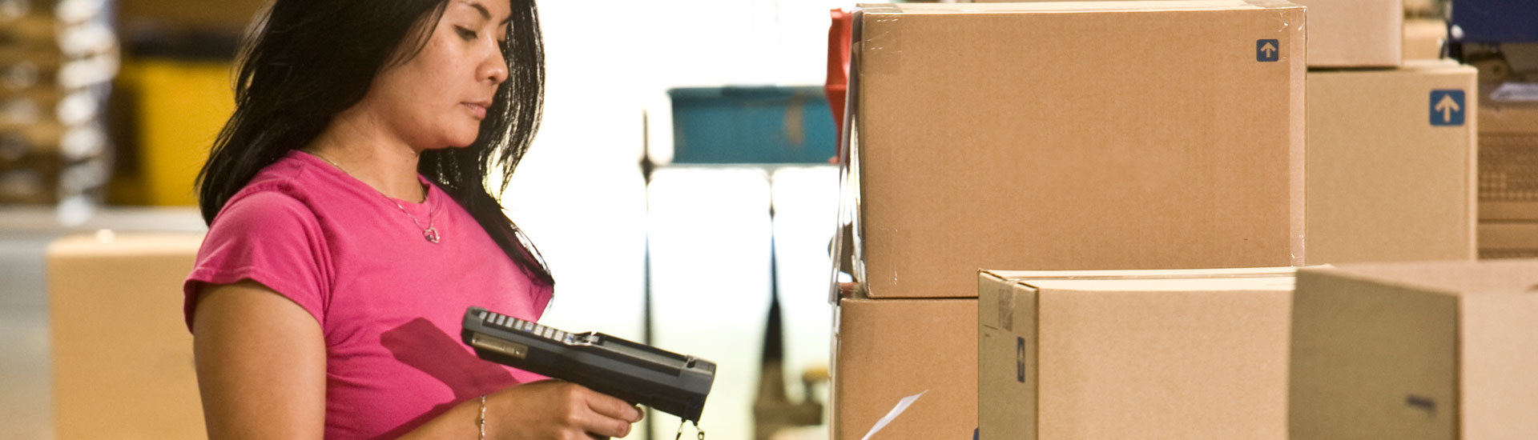
RFgen provides real-time, wireless connectivity to a wide range of systems and supports numerous warehouse operations like:
Inventory management
Receiving
Picking, packing and shipping
Manufacturing
Quality assurance
Time and attendance
Fast and Reliable Wireless and Mobile Data Collection

Slide 27

RFgen supports mobile on-demand access to your data from any Windows device.
Vendor managed inventory
Product returns
Drop ship
Proof of delivery
Direct store delivery
Field service/sales
Batch (yards, freezers, etc.)
On-Demand Mobile Enterprise Connectivity

Slide 28

RFgen provides the ability to continue operating 24/7, even when the host system is unavailable.
Remote and off-shore locations
Poor/occasional connectivity
Disconnected environments
Nightly/weekly back-ups
100% transaction visibility
High Availability Disconnected Solutions

Slide 29
SAP Business One Customer Success Story

Slide 30

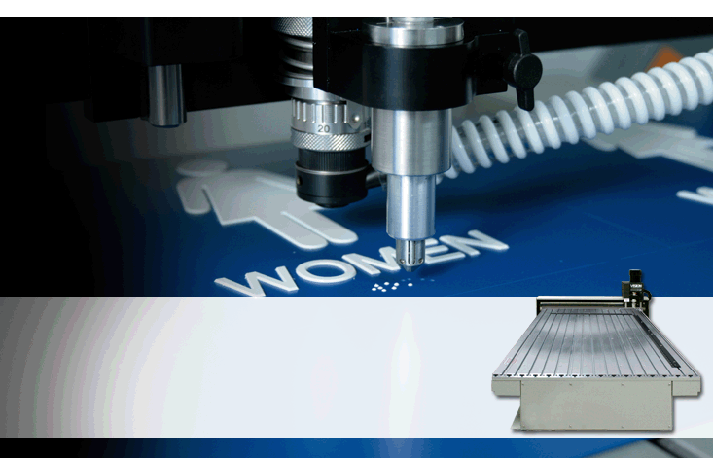
Company:
Industry:
Application:
Environment:
Vision Engraving & Routing Systems
Industrial and Commercial Machinery
Production Management
SAP Business One
The RFgen Solution:
Automated receiving, manufacturing and picking workflows; dramatically reducing paper-based processes.
Gained greater real-time visibility into inventory for better decision making by eliminating keyboard entry of data into SAP Business One.
Created an easier way to capture serial numbers on outbound shipments.
Enabled them to scale and grow without adding headcount.
Vision Engraving & Routing Systems manufactures computerized marking systems and accessories.
Notes:
Vision Engravers implemented the following transactions:
Issue to Production Order
Receive From Production Order
Work Queue by Worker

Slide 31
RFgen is a Total Solutions Provider
RFgen
Software
Hardware
Professional Services
Support
SAP-certified integration with SAP Business One
Suite of pre-built mobile apps
Mobile development studio for fast and easy application development
24/7 technical phone support
24/7 online support and resources
Classroom and online training
Certified reseller of major mobile device and hardware brands
Windows, Apple iOS and Android
Single vendor accountability
ERP integration expertise
Mobility and automation expertise
Supply chain and industry expertise

Slide 32
How [Prospect] Wins with RFgen
A solution for right now
Implement an Oracle-validated solution for SAP Business One that will meet your organizations exact needs for automated data capture today.
A solution that will evolve with you
Integrate multiple (disparate) systems and multiple ERP systems.
Integrate with third-party inventory management solutions.
Integrate with multi-carrier shipping and automated equipment.
Add new workflows, new product lines and new facilities.
Achieve a low total cost of ownership and quick ROI.
Administer one single-source platform for all your mobility and automation needs.
Manage and maintain one platform with minimal effort.
Easily upgrade your front-end systems when you upgrade your SAP Business One system.
A solution that provides value

Slide 33
Questions?
Contact
call | TBD
email | TBD
visit | TBD

Slide 34
Other Slides

Slide 35
The Advantages of Automation
Mobile Data Validation and Processing Against SAP Business One
Multiple options to meet your requirements:
Endless Mobile Worker Possibilities
Proof of delivery signature capture
Direct connect
Connect-on-demand
Batch on- and off-line (hybrid solutions)
Mobile field service
Sales order creation
Asset tracking/warranty tracking
Automation of Warehouse Activities
Eliminates manual processes
Increases data accuracy
Increases employee productivity
Real-time data validation and processing
Notes:
If you have a mobile workforce, RFgen’s mobile data validation and processing against JD Edwards gives you multiple options to meet your requirements including:
Direct connect, where you have a direct connection to your RFgen server via a 3G/4G device or smart phone.
Connect on demand, which allows you to collect transactions in a disconnected mode and then send those transactions to the RFgen server at your convenience.
Batch on and offline, which is a hybrid of direct connect and connect on demand.
There are endless mobile worker possibilities. Things like:
Proof of delivery signature capture, where you might have your own delivery fleet.
Mobile field service that allows you to track your parts inventory and transact against repair or service orders.
Sales order creation and customer service applications for your mobile sales force.
Asset tracking and warranty tracking for assets that may be in offsite locations.

Slide 36
Mobile Data Collection by the Numbers
Faster Training
Increase in Productivity
Increase in Efficiency
Increase in Accuracy
99%
25%
30%
80%

Slide 37
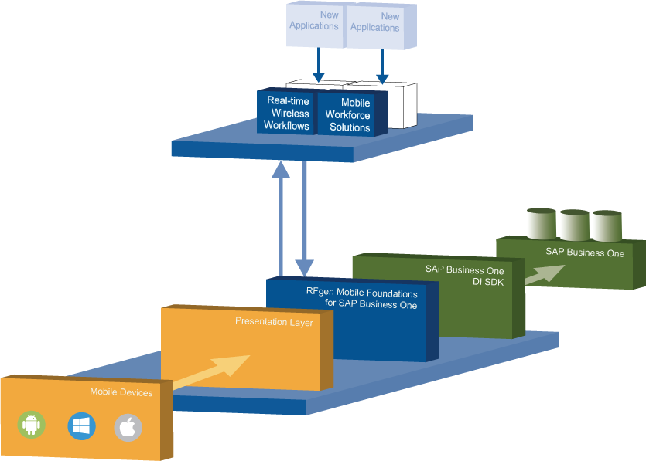
RFgen System Architecture

Slide 38
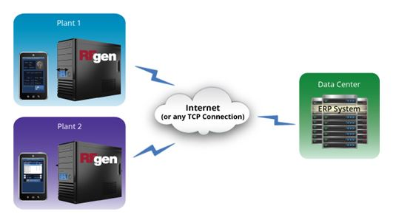
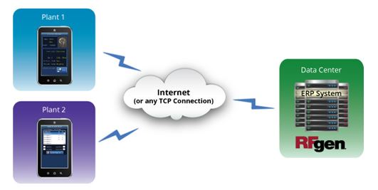
RFgen Architecture On-Premise
RFgen On-Premise
Scenario 1
RFgen On-Premise
Scenario 2

Slide 39
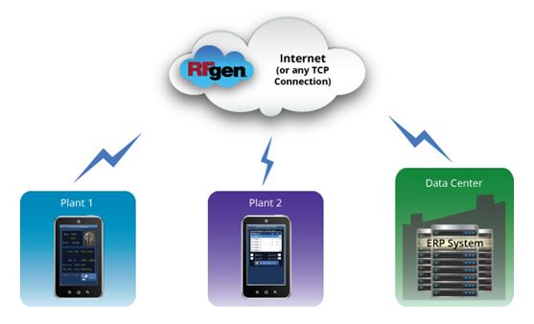
RFgen Architecture In the Cloud
RFgen in the Cloud

Slide 40
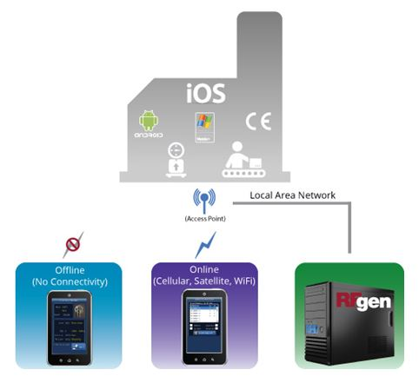
RFgen Connectivity Scenarios
RFgen in or Near the Plant

Slide 41
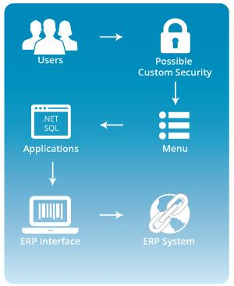
RFgen Application Framework

Slide 42
[Prospect Name]’s Business Challenge

Slide 43

[Prospect Name]’s Business Challenge
Briefly describe the prospect’s business challenge
Text
Text
Text

Slide 44

[Prospect Name]’s Expected Project Deliverables
Briefly outline what they hope to get by automating
Text
Text
Text

Slide 45



[Prospect Name]’s Requirements
Requirement | RFgen Meets Requirement
Text
Text
Text

Slide 46

How will RFgen Meet all of Your Requirements?
The flexibility and robustness of the RFgen Mobile Framework enables us to meet all of [Prospect Name]’s requirement for warehouse automation and mobility.
Let’s take a look at RFgen Mobile Foundations for SAP Business One.

Slide 47
Summary of Your RFgen Project
Turn-key solution for warehouse automation for the workflows listed to the right.
Meets the unique or specific requirements of each of the four distribution centers.
If there are other areas where efficiencies can be created we can incorporate them into this project very easily.
This solution can provide a mobile field sales application for your 250+ field reps.
Create increased efficiency / throughput
Reduction of direct labor
Increased inventory accuracy
eliminate manual processes and data entry
RFgen is very flexible and scalable
Transactions Includes in RFgen Solution
RFgen Distribution Suite
Cycle Count
PO Receipt by PO/Line
RFgen Warehouse Management
Warehouse Director
Put Away by Item
RFgen License Plate Suite
Create Entity
Assign Entity
Create LP Type
Create Plate
Attach Plate
Detach Item
Transfer LP
Pick, Pack, Ship (Outbound)
Pick to Plate
Ship Confirm Plate / Load
RFgen Inquiries
Item/Location Inquiry
Location Inquiry
Supply/Demand Inquiry
PO Inquiry by Item / Line

